Slide 1


Data Science Bootcamp
#1 rated Coding and Data Science Program in all of Orange County, Los Angeles, and the Inland Empire.
Prep Course Introduction - Statistics

Slide 2


Statistics
Statistics is the discipline that is concerned with the collection, organization, analysis, interpretation, and presentation of data.
Source: https://en.wikipedia.org/wiki/Statistics
Statistics is a science of collecting and analyzing data taken from a sample population
Notes:
The goal is to turn data into knowledge

Slide 3
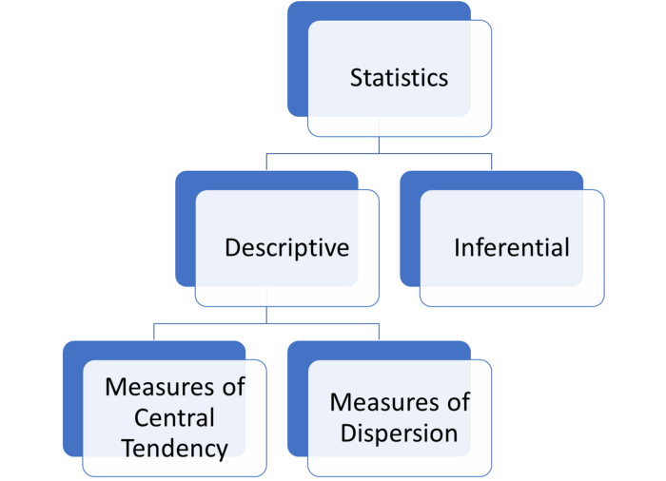
Statistics
Notes:
the first message for statistical thinking is, statistics derives knowledge from sample regarding the population by carefully conducted collection and data
Example of US election survey and its results
the first message for statistical thinking is, statistics derives knowledge from sample regarding the population by carefully conducted collection and data

Slide 4
Population vs Sample
Population
Population is the broader group of people to whom you intend to generalize the results
Sample
Sample is the specific group that you collect data from. To be a truly random sample, every subject in your target population must have an equal chance of being selected in your sample.
Notes:
the first message for statistical thinking is, statistics derives knowledge from sample regarding the population by carefully conducted collection and data
Example of US election survey and its results
the first message for statistical thinking is, statistics derives knowledge from sample regarding the population by carefully conducted collection and data

Slide 5
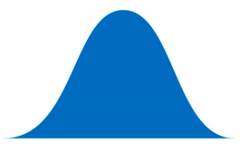
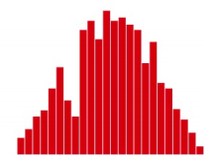
Population vs Sample
Population
Population
Sample
Sample
Notes:
the first message for statistical thinking is, statistics derives knowledge from sample regarding the population by carefully conducted collection and data
Example of US election survey and its results

Slide 6
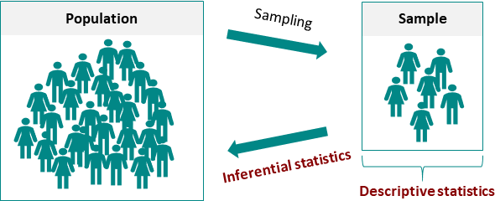
Statistics
Notes:
the first message for statistical thinking is, statistics derives knowledge from sample regarding the population by carefully conducted collection and data
Example of US election survey and its results
the first message for statistical thinking is, statistics derives knowledge from sample regarding the population by carefully conducted collection and data

Slide 7
Population vs Sample
N = Total population
n = Total sample from population

Slide 8
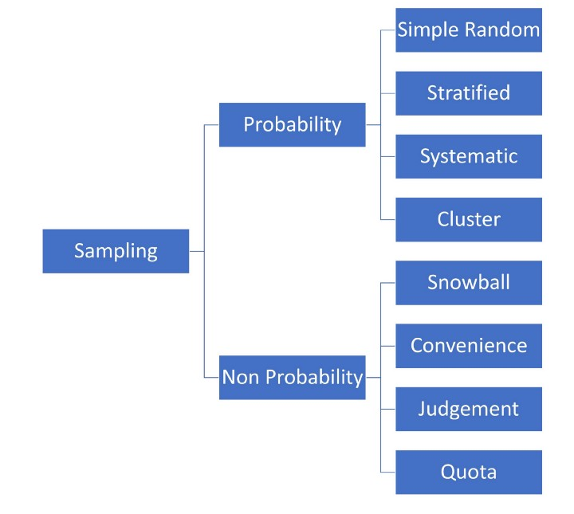
Statistics
Notes:
the first message for statistical thinking is, statistics derives knowledge from sample regarding the population by carefully conducted collection and data
Example of US election survey and its results
the first message for statistical thinking is, statistics derives knowledge from sample regarding the population by carefully conducted collection and data

Slide 9
Population vs Sample
Sample A subset from a larger data set.
Population The larger data set or idea of a data set.
N (n) The size of the population (sample).
Random sampling Drawing elements into a sample at random.
Simple random sample The sample that results from random sampling without stratifying the population.
Sampling with replacement and without replacement

Slide 10
Statisticians and Data Scientists
A sample to a statistician means a collection of data points.
Data scientists will use the term sample for a single data point.

Slide 11
Statisticians and Data Scientists
Statistician, predictor variables are used in a model to predict a response or dependent variable.
For a data scientist, features are used to predict a target.

Slide 12
Data
Data Generation
Data Collection
Knowledge
Business Intelligence
Solutions
Notes:
We have little control on data generation
From generated data we gather data to analysis
We want to drive knowledge, business intelligence and solution based on our data

Slide 13
Data
5
Data is usually a number, for a unit of observation and has a context
Notes:
Data is usually a number, for a unit of observation and has a context
Does 5 mean Age of 5 - years
Height of the person 5 feet
Weight of the person 5 pounds
Does it mean 5ml of rain

Slide 14
Type of data
Types of variable
Quantitative variables
Qualitative variables
Date and time

Slide 15
Quantitative Variable
Types of Quantitative variable
Continuous variables
Discrete variables
Notes:
Discrete data is similar, but is still numeric. An example of discrete data is the sum of two dice thrown. There are a finite and known set of outcomes, but these outcomes are represented numerically. Continuous data concerns data that can take on infinite values between any two points. A good example that really proves this point is that there are infinite values between 1 and 1.01. Continuous data is generally numeric, like in our example above, but can sometimes be represented in date-time format.

Slide 16
Qualitative Variable
Types of Qualitative variable
Ordinal variables
Nominal variables
Notes:
Categorical data is non-numeric and often can be characterized into categories or groups. A simple example is is color; red, blue, and yellow are all distinct colors. Another example could be age groups or other interval-type data. Like 1–25 years old, 25–50 years old, and so on. The data used represents numbers, but the intervals themselves are categorical.

Slide 17
Fundamental Ideas
Estimates of Location
Variance
Uncertainty
Probability

Slide 18
Centrality Measures/ Descriptive statistics
Central tendency measures, which capture the center around which the data is distributed.
Variation or variability measures, which describe the data spread, i.e. how far the measurements lie from the center.

Slide 19
Estimates of Location
Mean: The sum of all values divided by the number of values. Synonyms average
Median: The value such that one-half of the data lies above and below. Synonyms 50th percentile
Mode: The most frequent value
Outlier: A data value that is very different from most of the data. Synonyms extreme value

Slide 20
Central tendency measures
Mean
Arithmetic mean
Weighted mean
Geometric mean
Median
Mode
Notes:
geometric mean is a mean or average, which indicates the central tendency or typical value of a set of numbers by using the product of their values (as opposed to the arithmetic mean which uses their sum).

Slide 21
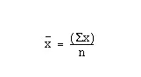
Mean
Average
μ = Mean of population
x = Mean of sample

Slide 22
Mean
Let’s write a function to calculate the mean of a given dataset
1, 2, 4, 5, 5, 7, 8, 9

Slide 23
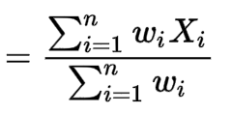
Weighted Mean
μ = Mean of population
x = Mean of sample

Slide 24
Weighted Mean
Let’s write a function to calculator mean of a given dataset
Weighted Values Student 1 Students 2
HW | 15%
Quiz | 15%
Mid term | 35%
Final | 35%
HW | 78
Quiz | 70
Mid term | 89
Final | 94
HW | 100
Quiz | 97
Mid term | 76
Final | 79

Slide 25
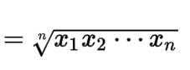
Geometric Mean
μ = Mean of population
x = Mean of sample

Slide 26
Geometric Mean
Let’s write a function to calculator geometric mean of a given data
1, 2, 4, 5, 5, 7, 8, 9

Slide 27
Median
Write a function to find the centre point (50% percentile) of the data
1, 2, 4, 5, 5, 8, 9
1, 2, 4, 5, 5, 7, 8,9

Slide 28
Mode
Write a function to find the most frequent number in the data
1, 2, 4, 5, 5, 8, 8, 9

Slide 29
Estimates of Location
Mean: The sum of all values divided by the number of values. Synonyms average
Weighted mean: The sum of all values times a weight divided by the sum of the weights. Synonyms weighted average
Geometric mean is calculated by multiplying all numbers and then taking the nth root of that number (where n=number of numbers).
Trimmed mean: The average of all values after dropping a fixed number of extreme values. Synonyms truncated mean

Slide 30
Variability measures
Variance
Standard Deviation
Coefficient Variation
Notes:
geometric mean is a mean or average, which indicates the central tendency or typical value of a set of numbers by using the product of their values (as opposed to the arithmetic mean which uses their sum).

Slide 31
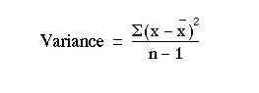
Variance
Spread of data around the mean
𝛔² = Variance of population
S² = Variance of sample
Notes:
Why divide by n-1 : https://www.willemsleegers.com/post/2020/08/05/why-divide-by-n-1/
Bias and unbias : https://www.merriam-webster.com/dictionary/unbiased

Slide 32
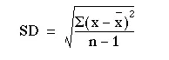
Standard deviation
Square root of variance
𝛔 = Standard deviation of population
s = Standard deviation of sample

Slide 33
Variance
Numbers1 = 3, 4, 4.5, 3.5
Numbers2 = 4.828, 6.437, 7.242, 5.632

Slide 34
Coefficient of variation
Compare two datasets which operate on different scales i.e miles and kilometers
Coefficient of variation = Standard deviation / Mean
Miles = 3, 4, 4.5, 3.5
Kms = 4.828, 6.437, 7.242, 5.632

Slide 35
Covariance

Slide 36
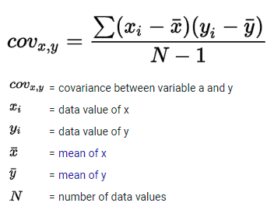
Covariance
Covariance if two values are moving in the same direction
Age | Internet use
18 | 125
25 | 120
40 | 100
50 | 70

